Slide 1

Weather Forecasting Application
Ajay kumar -211000090
Alok Rai – 2115000120
Aman Pratap Singh -2115000133
Nilanshu Rai - 2115000673
GLA University, Mathura
B. tech(CS)
Nov 24 ,2023

Slide 2
Introduction
A weather application is a digital tool designed to provide real-time or forecasted weather information to users. These applications utilize data from various sources like meteorological agencies, satellites, weather stations, and sensors to offer a comprehensive overview of current conditions, forecasts, and weather-related alerts.
Weather apps serve a variety of purposes, from everyday planning and outfit choices to aiding in travel decisions and ensuring safety during severe weather events. They are available across various platforms such as smartphones, tablets, and desktops, catering to users seeking reliable and up-to-date weather information at their fingertips.

Slide 3
Objectives
Objectives of our project
Data Collection
Real-time Update
Search Functionality
Customization Options
Source Diversification
What you aim to achieve with this project
Information Accessibility
Forecasting and Prediction
User Convenience
Safety and Preparedness
Real-time Update

Slide 4
Literature Review
Technological Evolution
User Experience and Interface Design
Impact on Decision-Making
Accuracy and Reliability
User Behavior and Adoption
Impact on Societal Functions
Challenges and Ethical Considerations
Future Directions and Innovation

Slide 5
Methodology
Data Collection
Algorithm Development
Requirement Analysis
User Interface Design
Real-time Updates
Data Processing and Analysis
User Interface (UI) and User Experience (UX) Design

Slide 6
System Architecture
Data Sources: Weather applications gather data from various sources, including meteorological agencies, weather stations, satellites, sensors, and APIs from weather service providers.
Data Ingestion Layer: This layer handles the collection of raw weather data from different sources. It involves APIs, data streaming services, or scheduled data downloads to fetch information like temperature, humidity, wind speed, precipitation, and more.
Data Processing and Storage: Once collected, the data needs processing and storage. This involves cleaning, validating, and transforming the raw data.
Data Analysis and Prediction: Advanced algorithms and models are applied to the processed data to analyze patterns and make predictions.

Slide 7
Application Backend: This layer manages the business logic of the application. It interacts with the data processing and storage components to retrieve weather information and handles user requests. It might also involve caching mechanisms to optimize data retrieval.
APIs and Services: APIs are used to expose functionalities to different parts of the application, allowing access to weather data and services. These APIs might include location-based services, mapping services, weather forecast APIs, and authentication services.
User Interface (UI) Layer: The frontend of the weather application is responsible for presenting weather information to users. It includes the graphical user interface (GUI), visual elements such as maps, charts, and widgets, and user interaction functionalities.
Mobile or Web Application: The actual weather application interface that users interact with, whether it's a mobile app or a web-based application. This layer connects to the backend services to fetch and display weather data to users.
Push Notification Services: For alerts and notifications about severe weather conditions or personalized updates, push notification services are integrated to notify users based on their preferences and location.
Security and Authentication: Security measures such as encryption, authentication protocols, and access controls are implemented to protect user data and ensure secure communication between different layers of the application.

Slide 8
Implementation
Planning and Design
Data Collection
Real-time Updates
Gathering Weather Data
Implementing Weather Forecast Algorithms

Slide 9
Features
Key features
Current Conditions
Hourly and Daily Forecasts
Interactive Maps
Severe Weather Alerts
Multiple Locations
Customization
Weather Widgets
Historical Weather Data
Astronomical Information
Air Quality Index (AQI) and Pollen Count
Weather Radar and Forecasting Models
Push Notifications
Social Sharing:

Slide 10
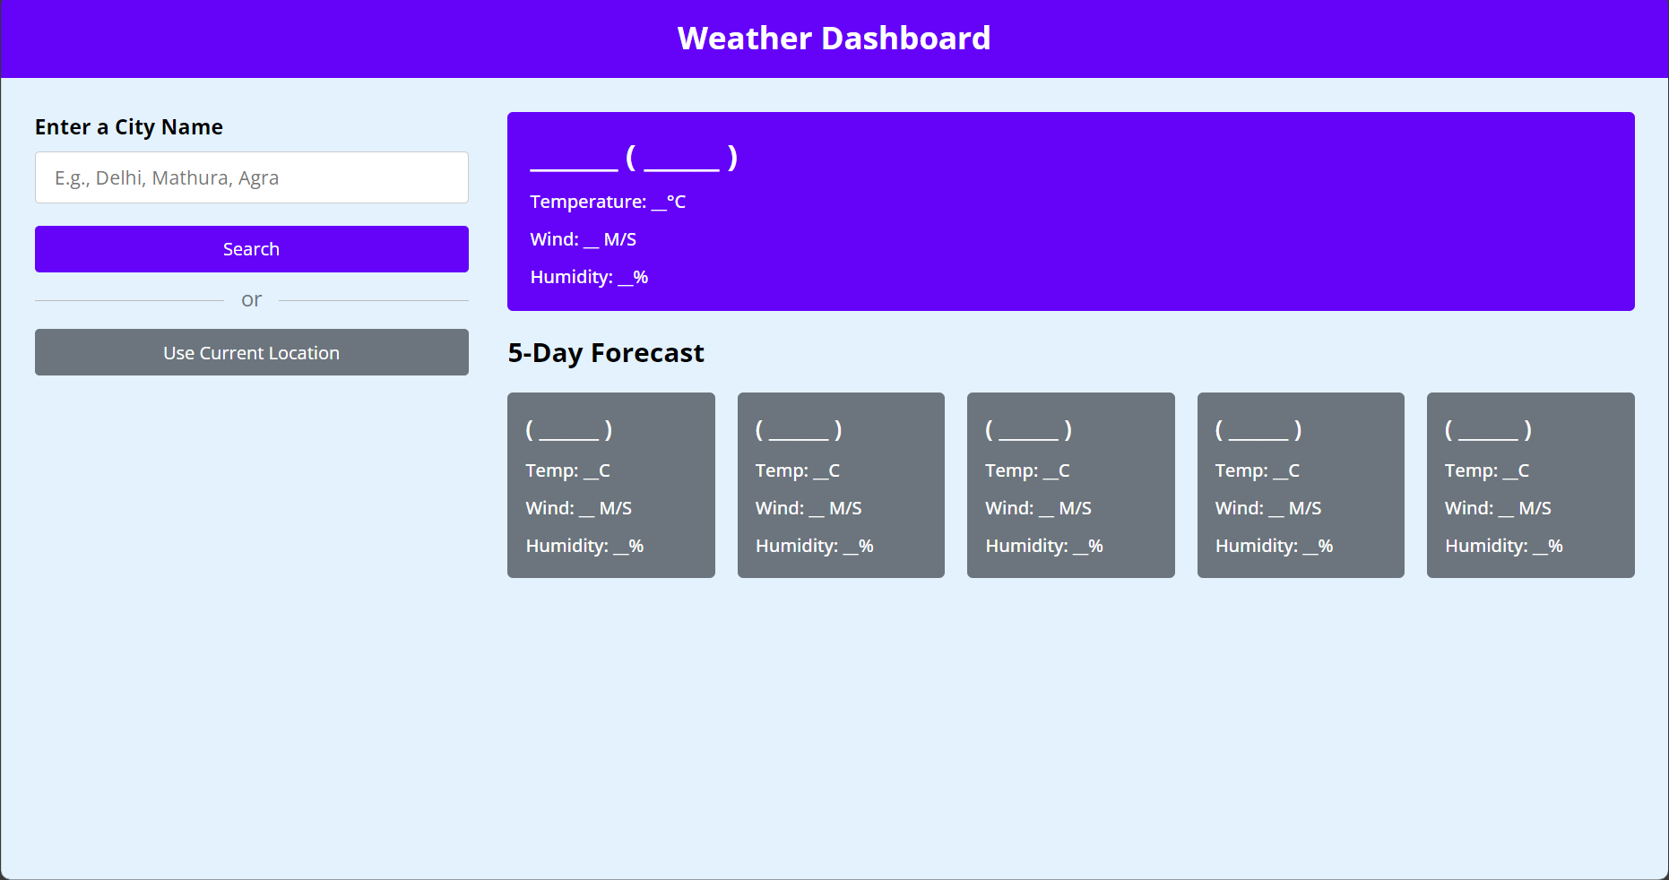
Results
Visual representation

Slide 11
Challenges Faced
Data Accuracy and Reliability
Complexity of Weather Prediction:
Localized and Hyper-Localized Forecasting
Handling Severe Weather Events
User Engagement and Retention
Technical Infrastructure and Costs:
Data Privacy and Security
User Experience and Interface Design
Global Coverage and Data Availability

Slide 12
Future Work
Improved Forecast Accuracy
Hyper-localized Weather Forecasting
Enhanced Real-time Data
Personalization and Contextualization

Slide 13
Conclusion
Weather applications play a vital role in providing accessible, accurate, and timely weather information to users worldwide. These applications have evolved significantly, offering a range of features such as current conditions, forecasts, alerts, and personalized settings to cater to diverse user needs.
Through the amalgamation of advanced technologies like machine learning, APIs, geolocation services, and data visualization tools, weather apps have enhanced their capabilities in delivering precise weather forecasts and improving user experience.
Despite advancements, challenges persist, including ensuring data accuracy, improving localized forecasting, handling severe weather events, and maintaining user engagement in a competitive market.

Slide 14
Acknowledgments
We express our sincere gratitude and appreciation to all individuals and organizations who have contributed to the successful development and implementation of the Weather forecasting application.
Project Team : We extend our thanks to the dedicated and talented team members who played pivotal roles in designing, developing, and deploying the Weather forecasting application.
Thank You

Slide 15
Q&A
Open the floor for questions from the audience

